Slide 1
FINAL PROJECT
DIBIMBING -Modeling And Optimization Techniques In Data Warehousing Bootcamp 2023
KELOMPOK 5

Slide 2
Headline
Introduction
Analysis and Visualization
Project Description
Improvement

Slide 3
Introduction

Slide 4
Task
ETL/ELT Job Creation using Airflow
Data Modeling in Postgres
Dashboard Creation with Data Visualization
Craft a Presentation Based on Your Work

Slide 5
Project Description

Slide 6
ETL/ELT Job Creation using Airflow

Slide 7
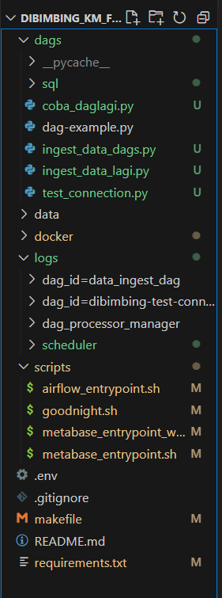
Struktur Folder

Slide 8
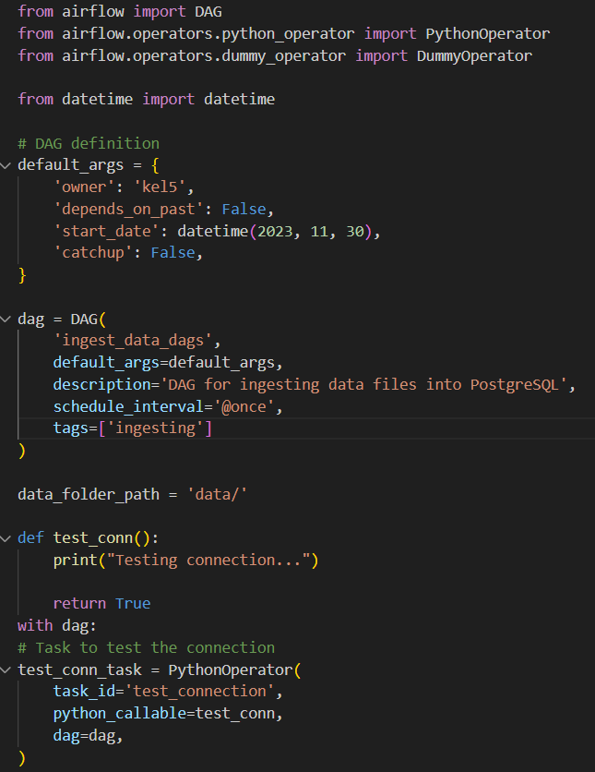
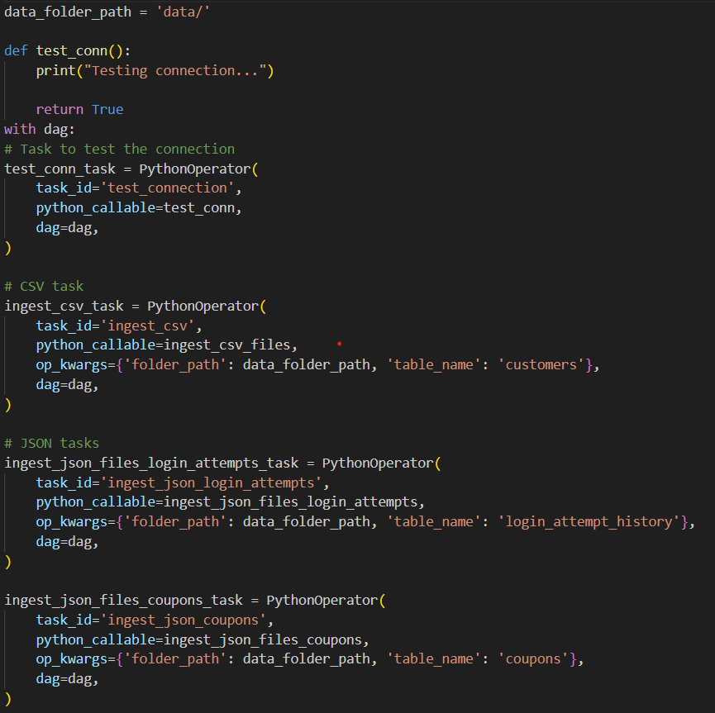
DAG

Slide 9
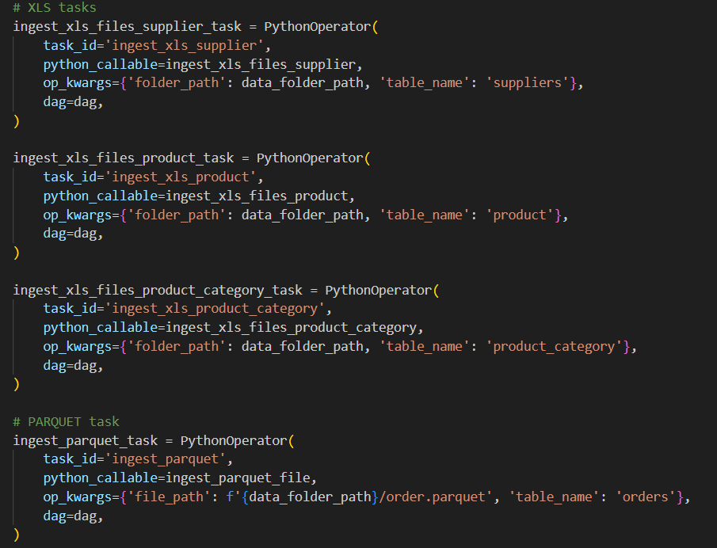
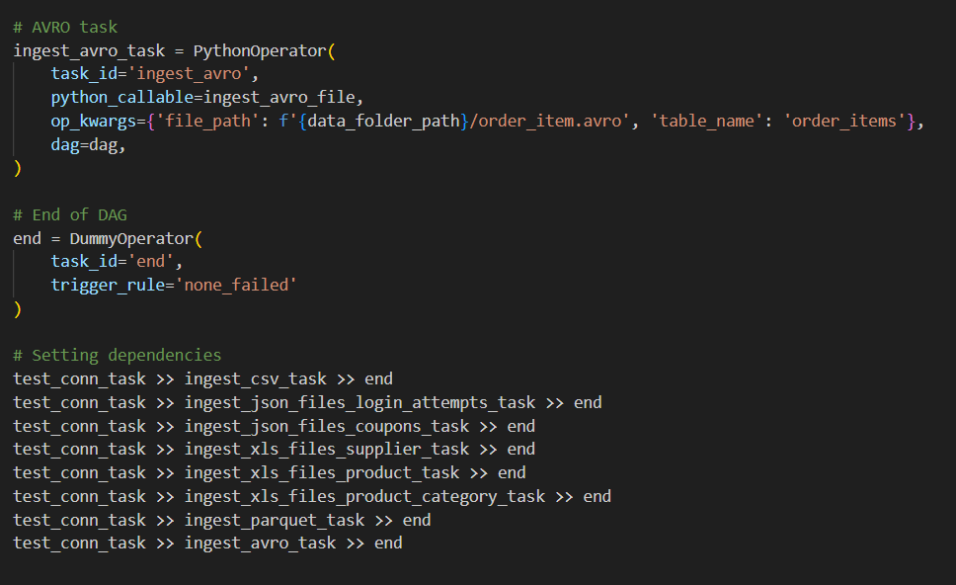
DAG

Slide 10
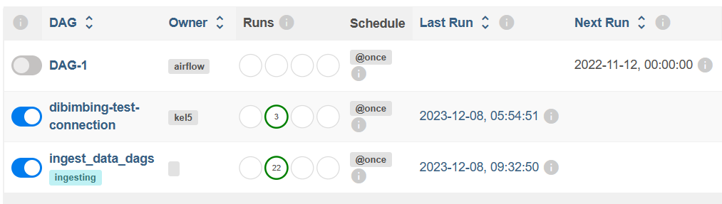
DAG

Slide 11
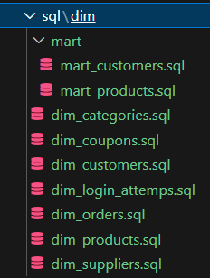
Data Modeling in Postgres

Slide 12
Priview Data Modeling in Postgres

Slide 13
Analysis and Visualization

Slide 14
Dashboard Creation with Data Visualization

Slide 15
Improvement

Slide 16
4000
3000
2000
1000
0
You can insert graphs from Excel or Google Sheets

Slide 17

Free templates for all your presentation needs
For PowerPoint and Google Slides
100% free for personal or commercial use
Ready to use, professional and customizable
Blow your audience away with attractive visuals

